Slide 1
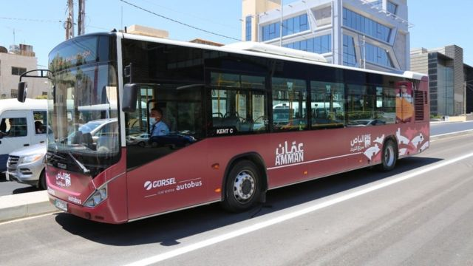
BTRS Project

Slide 2
Introduction
We are planning to launch a public bus transportation reservation system website which we programmed using asp.net core mvc and we made the passenger UI pages using Figma

Slide 3
Problem
As the population grows in the world in general and in Jordan In particular leading to increasing of Demand on transportation as well as the need for new and better solutions so we came out with BTRS

Slide 4
Solution
BTRS is a bust transportation system website that allows the user/passenger to move around in Jordan so he can choose between a lot of trips from one location to another and all previous trips are saved in the log which mean that he can save his favourite trips details like destination and payment method so that he can re-use them like if the passenger uses our website everyday to go to work which makes it a lot easier for him,many buses are entitled for each trip to keep-up if there’s huge demand on one trip in particular

Slide 5
Development process
First we made the UI Using Figma and included everything the passenger might need after logging in for existing users or registration for new ones the user gets directed to the main menu but before that in case he forgot his password the user can reset it using either phone number or email address now we go back to the UI the user gets too choose as many trips as he wants throughout the day (one for the mean time and others for later) which fit his time schedule and destination and he can as well choose trips that have the same course as his previous ones without having to pick the destination and payment method again then he books his ticket and gets a digital copy of it and he can print it as well after that may he enjoy his ride

Slide 6
Suggestions for Enhancement
As we are in our early stages of the project we didn’t include a lot of features but we’re looking forward to make a mobile app for our website as well as incentives system such as discounts ,vouchers and a rating system for each bus/bus driver and we are planning to introduce a brand new option for early reservations so that the passenger can choose his seat when booking a ticket

